Slide 1
You did it! ♥

Slide 2
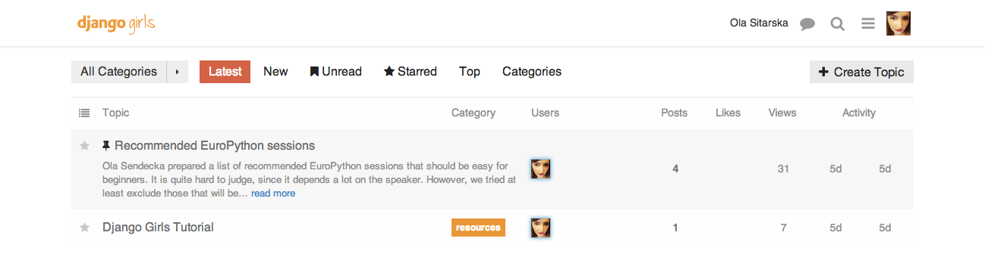
http://community.djangogirls.org/

Slide 4
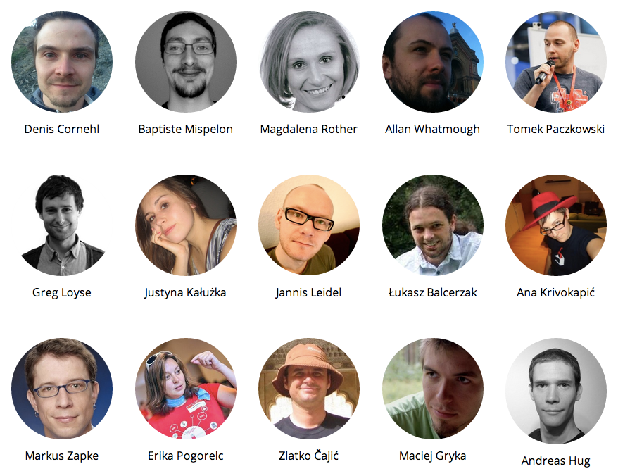
Thank you!

Slide 5

Thank you!

Slide 6
EuroPython time!
http://bit.ly/epbeginner

Slide 7

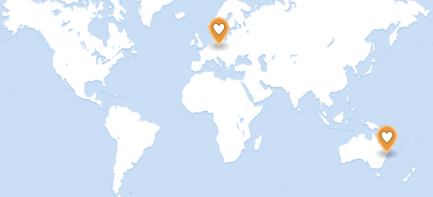
today

Slide 8
tomorrow!

Slide 9
Warszawa

Slide 10
Kraków

Slide 11
London

Slide 12

Your city?
hello@djangogirls.org

Slide 13
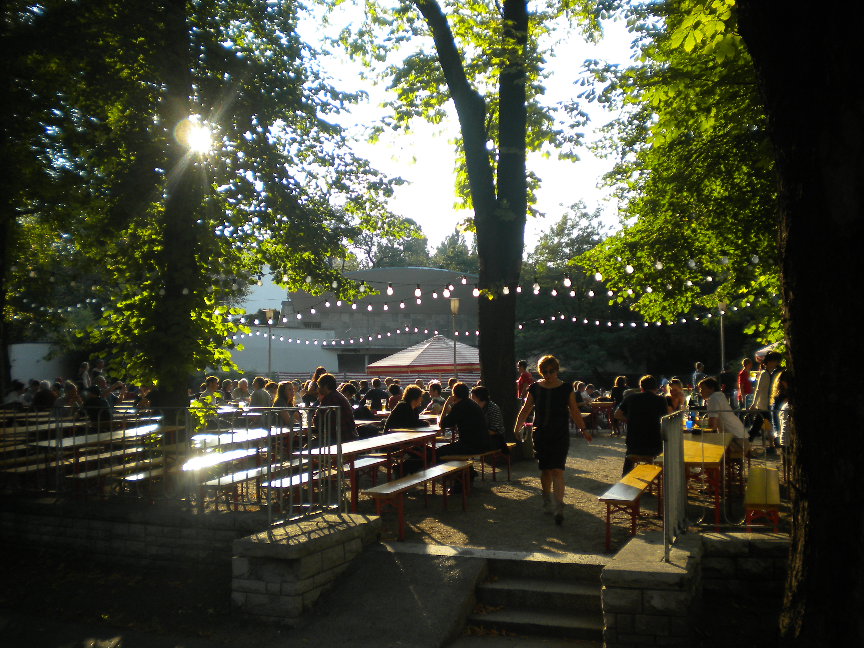
Prater Garten
Kastanienallee Straße 7-9
U-Bahn U2 to Eberswalder station

